Slide 1

Catalog
Created By Gavin Browning

Slide 2
Proposal
A Database catalog of various new powersports which are sold at Moto United
Uses SQLite Open Helper to retrieve data
This catalog can be sorted into 4 groups: ATVs, SXS, Motorcycles, and Watercraft
When a object is clicked, a DetailActivity opens, showing a price and description
On the home page there is a Contact button that opens an info page (phone, etc.)
There is also a Used/Deals button that opens a list of used and/or cheap objects
The display map button opens the coordinates to the St. George Moto United
There is an email list you can opt into, and also a way to sign into the app.

Slide 3
How Far I got
I managed to get a lot of what I proposed done.
I have a functioning data base of powersports both sortable and filled with prices and descriptions.
The home page has all of the initial features I wanted: Contact info, Map, Deals/Used powersports.
The only thing that came short was coding a map that knows your location and can take you to any of the 5 locations of Moto United. A reasoning for this is that I cant update any of the Google APIs and I get an “Update Google Play Services” error because they are outdated.

Slide 4
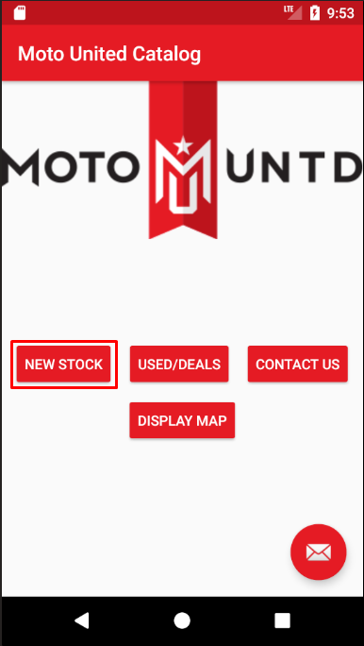
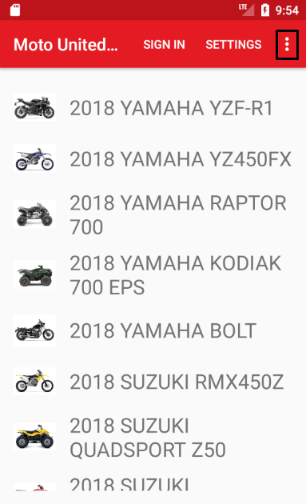
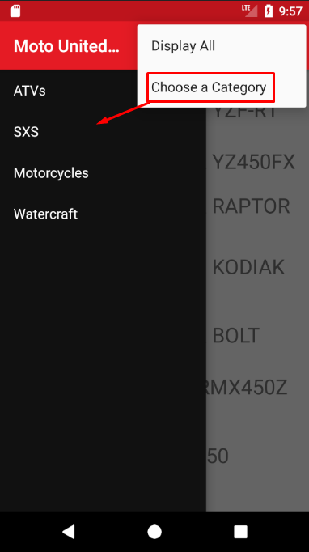
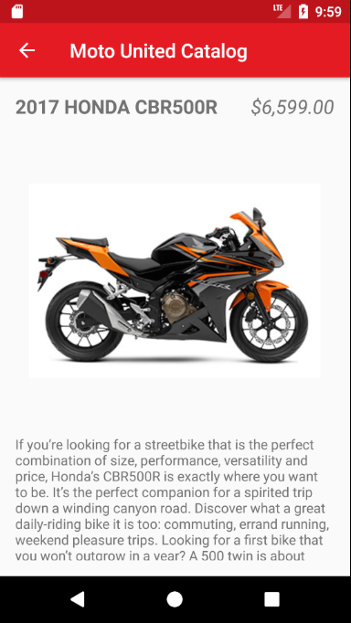
New Stock Catalog

Slide 5
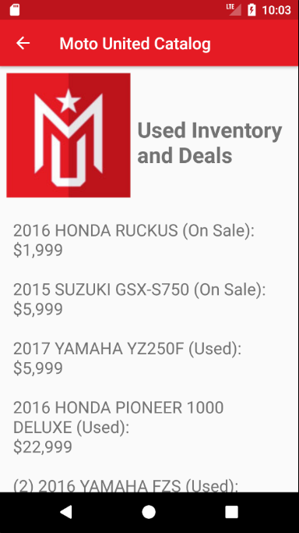
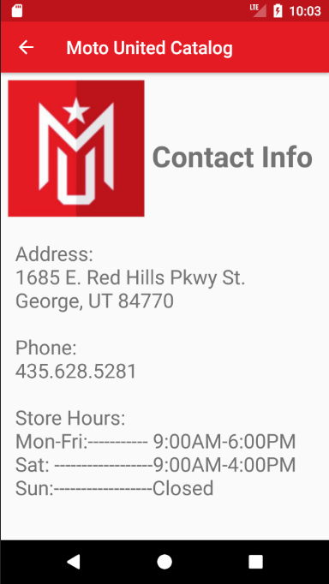
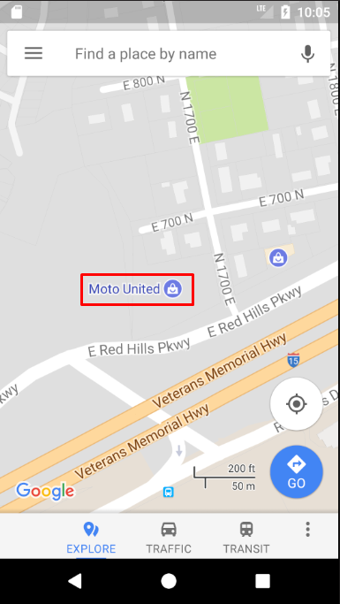
Other info
The Used Inventory and Deals page is scrollable.
The Display Map button opens google maps right to where Moto United is.

Slide 6
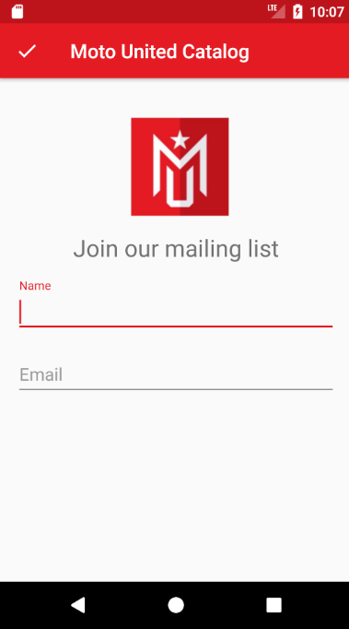
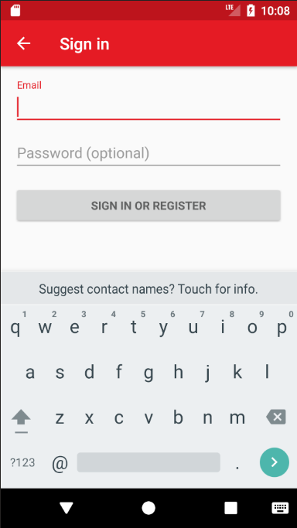
Email & Sign In
Mailing list is accessible through the floating action button on the home page.
Sign in page is accessible through the New Stock Catalog at the top.

